Slide 1
#5 Final System and Subsystem breakdown
Delete slide before inserting into active

Slide 2
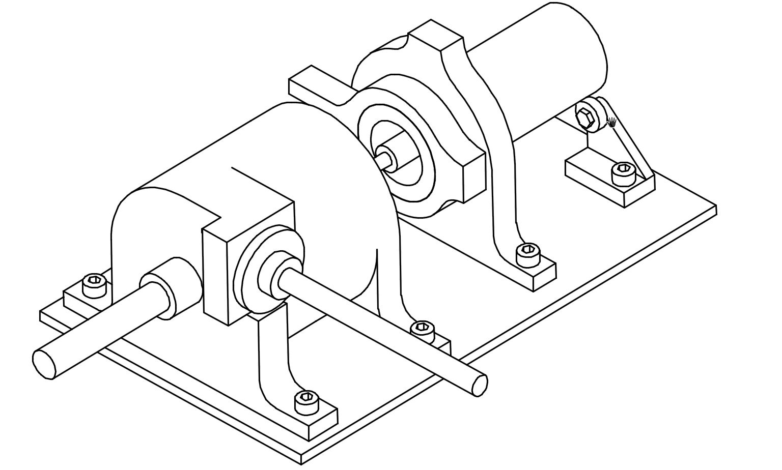
Electric Feed System: Final Design and Subsystems
High speeds and loads with low tolerances meant fabrication had to be precise.

Slide 3
EFS Subsystems
Hydraulic
Mechanical
Power
Flow Loop
Measurement
Impeller
Diffuser
Volute
Bearings
Seals
Shaft
Coupling
Alignment
Motor
Batteries
ESC
Control
Supply Tank
Valves
Tubing
Arduino
Excel DAQ
Sensors

Slide 4
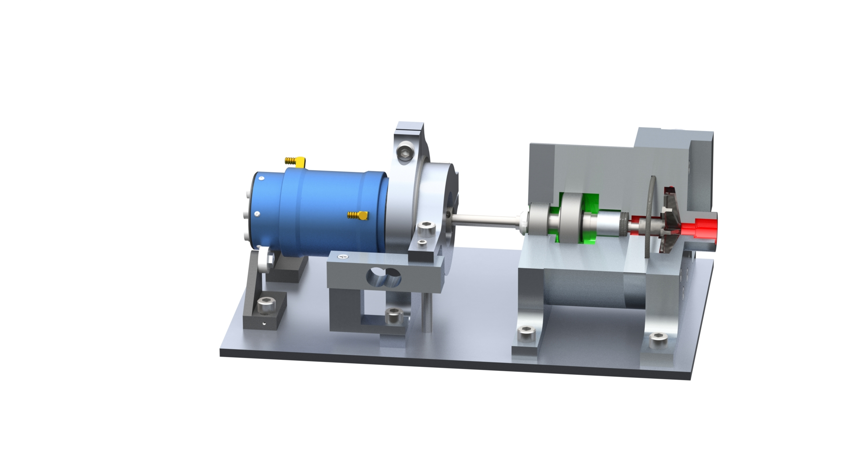
EFS Subsystems
Mechanical
Bearings
Seals
Shaft
Coupling
Alignment
Power
Motor
Hydraulic
Impeller
Diffuser
Volute

Slide 5
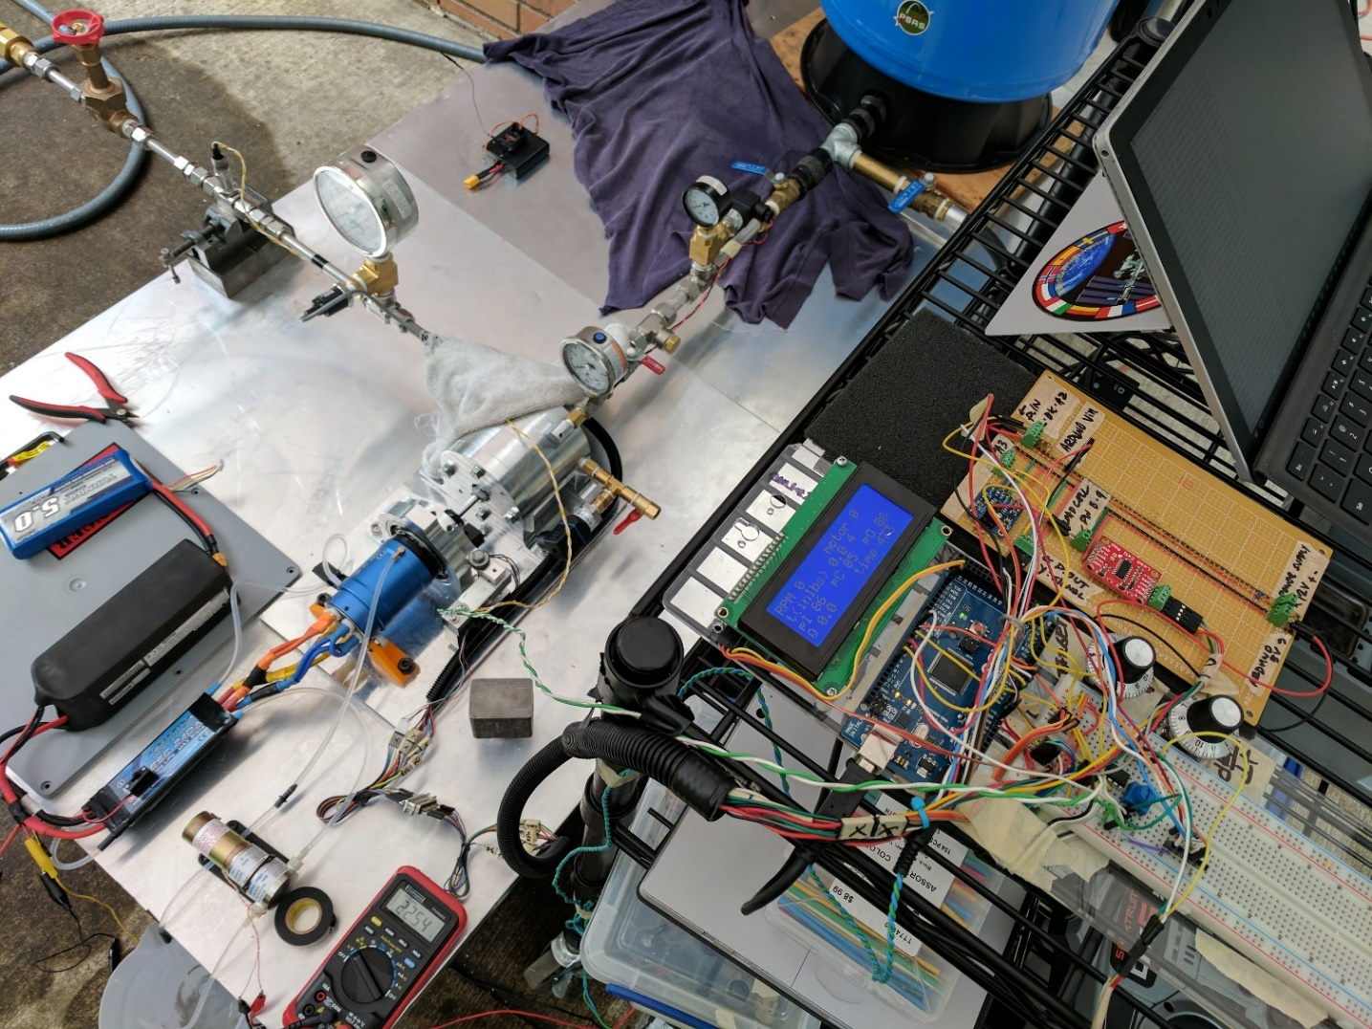
EFS Subsystems
Hydraulic
&
Mechanical
Flow Loop
Supply Tank
Valves
Tubing
Impeller
Diffuser
Volute
Bearings
Seals
Shaft
Coupling
Alignment
Measurement
Arduino
Excel DAQ
Sensors
Power
Motor
Batteries
ESC
Control
Cooling

Slide 6
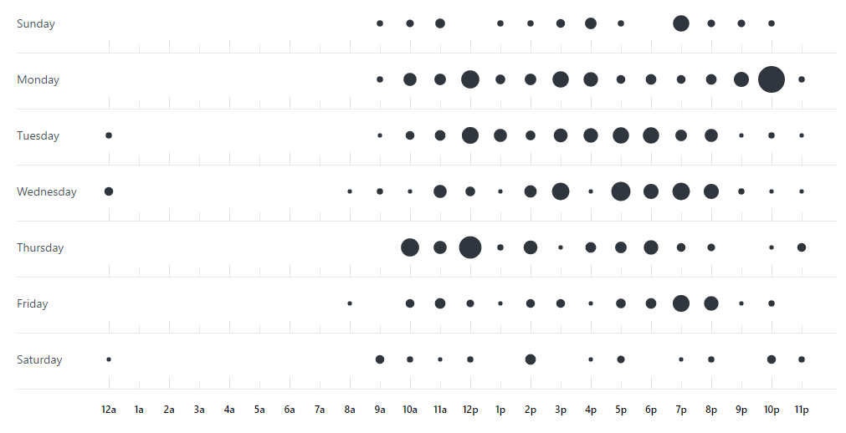
Punch card

